Slide 1
Making Parents Partners in Youth Suicide Prevention
Dorian Lamis, PhD, ABPP
Clinical Psychologist/Assistant Professor
Emory University School of Medicine
Notes:
ABOUT SPTS-
The Society for the Prevention of Teen Suicide (SPTS) was started in 2006 by two fathers who had lost teenaged children to suicide. There’s an intensity and passion that infuses a cause when it is borne out of personal tragedy and SPTS is no exception. Scott Fritz and Don Quigley were determined to do whatever they could to protect other families from the destruction of suicide and they had no trouble recruiting their golf buddies, Todd Cohen, Jerry Grasso, Tom Lanning, and Bob Agle to join them. Realizing they needed professional expertise to inform their mission, they invited clinical social worker Maureen Underwood, a nationally recognized expert in youth suicide, to become part of their team. The New Jersey Chapter of the American Association of Suicide Prevention was represented through President Peggy Farrell, and school administrator Janine Grasso and college vice president Mary Anne Nagy rounded out the initial board.
The Core Values that define SPTS and its founding board are :
Passionate commitment to the value of life
Belief in the effectiveness of evidence-based suicide prevention strategies
Dedication to removing public stigma about suicide, and
Conviction that accurate information and education about suicide can save lives.
Many organizations and groups around the country are dedicated to youth suicide prevention. One of the things that make SPTS unique, however, is its combination of business savvy with the knowledge of evidence-based mental health practices. This affiliation has enabled SPTS to work quickly, efficiently, and decisively to develop and implement youth suicide prevention programs at both the state and national level. Our long-term direction and vision is to become an international resource for youth suicide awareness and prevention programs that reflect our core values.
OUR MISSION:
We are dedicated to saving the lives of youth that would be lost to suicide by developing and supporting initiatives that combine the can-do attitude of business with the expertise and knowledge of mental health.

Slide 2
Why Talk About Youth Suicide?
We teach our kids about seat-belt safety, to stop, drop and roll in case of fire, about the dangers of drug and alcohol use, about safe sex practices- yet do not address what is the 2nd leading cause of death in our youth- after accidents and homicides- and that is suicide

Slide 3
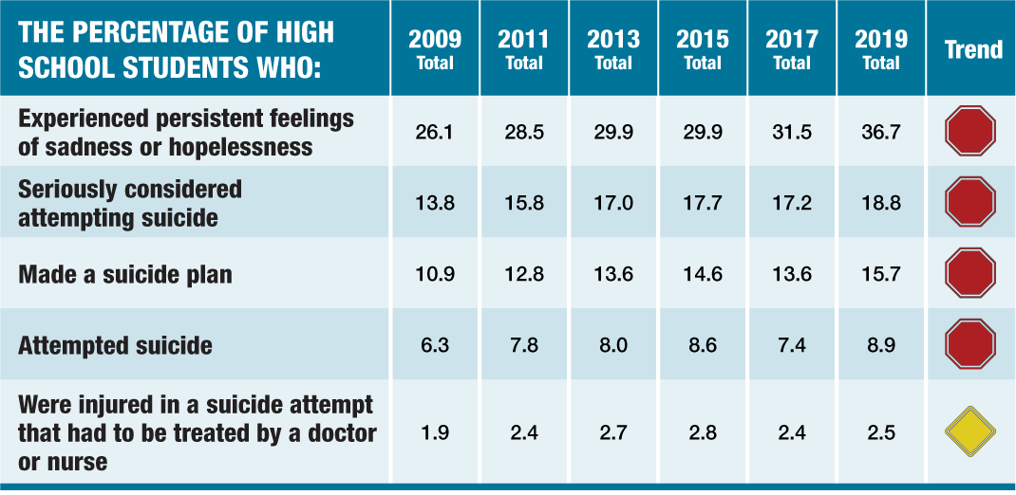
Why Suicide Prevention Is Important
Notes:
These are still just numbers- Let me read to you a couple of things from parents- show video clips from parents?- that speak with great eloquence about why this is so important

Slide 4
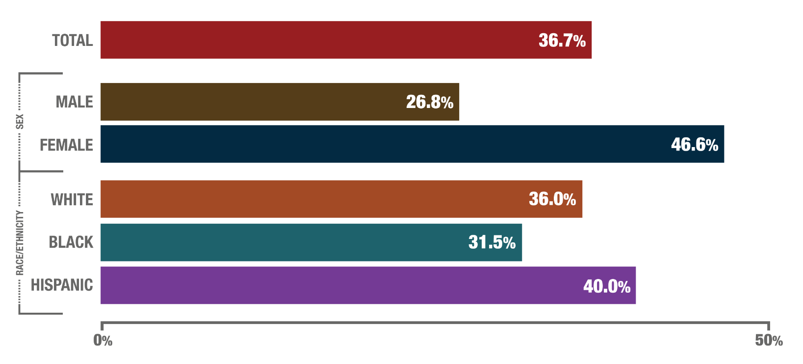
PERCENTAGE OF HIGH SCHOOL STUDENTS WHO EXPERIENCED PERSISTENT FEELINGS OF SADNESS OR HOPELESSNESS DURING THE PAST YEAR, BY SEX AND BY RACE/ETHNICITY, UNITED STATES, YRBS, 2019
Notes:
In 2019, about 37% of high school students had experienced periods of persistent feelings of sadness or hopelessness during the past year. Persistent feelings of sadness or hopelessness are defined as feeling so sad or hopeless almost every day for two weeks or more in a row that the student stopped doing their usual activities. Almost half of female students experienced persistent feelings of sadness or hopelessness in 2019.
More female students experienced these feelings than male students.
More Hispanic students experienced these feelings than white students or black students.
More white students experienced these feelings than black students.

Slide 5
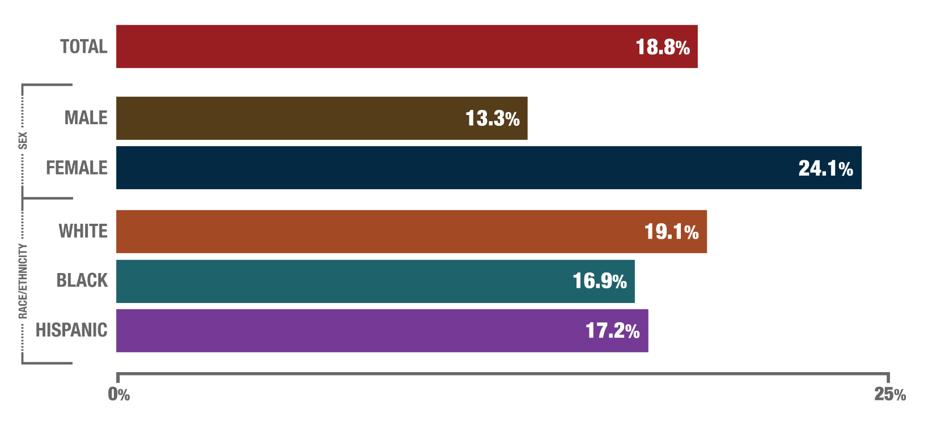
PERCENTAGE OF HIGH SCHOOL STUDENTS WHO SERIOUSLY CONSIDERED ATTEMPTING SUICIDE DURING THE PAST YEAR, BY SEX AND BY RACE/ETHNICITY, UNITED STATES, YRBS, 2019
Notes:
In 2019, about 19% of all high school students (nearly 1 in 5) and about 24% (1 in 4) of female students had seriously considered attempting suicide during the past year.
More female students than male students had seriously considered attempting suicide.
More white students seriously considered attempting suicide than black students.

Slide 6
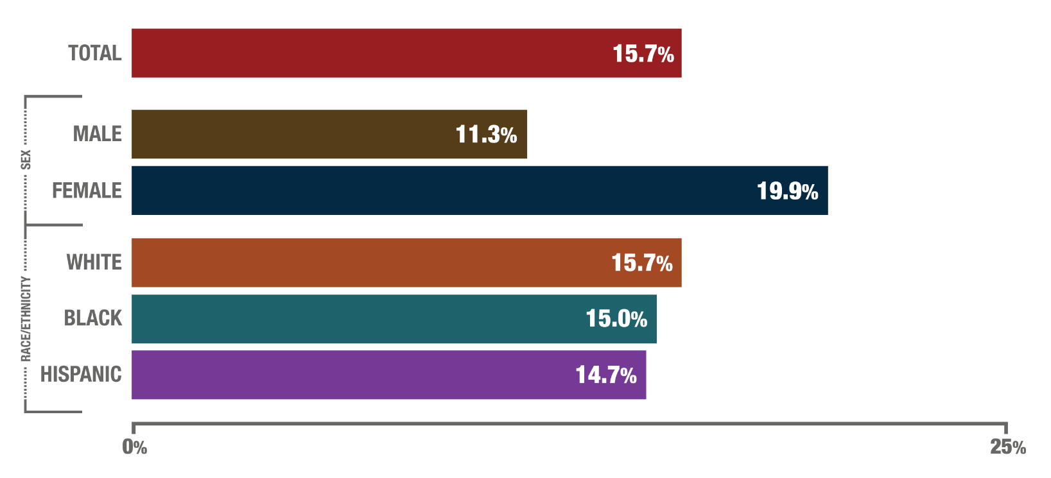
PERCENTAGE OF HIGH SCHOOL STUDENTS WHO MADE A SUICIDE PLAN DURING THE PAST YEAR, BY SEX AND BY RACE/ETHNICITY, UNITED STATES, YRBS, 2019
Notes:
In 2019, about 16% of high school students had made a suicide plan during the past year.
More female students (1 in 5) made a suicide plan than male students.

Slide 7
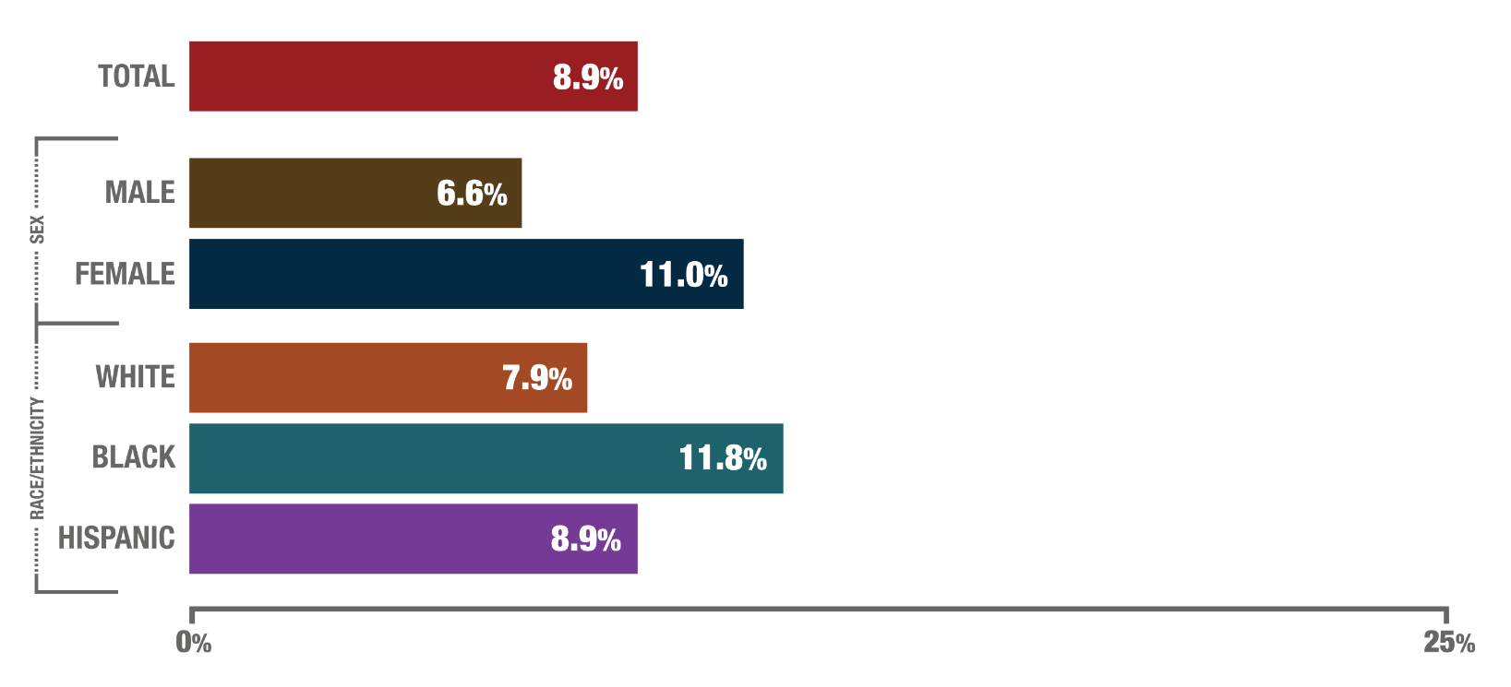
PERCENTAGE OF HIGH SCHOOL STUDENTS WHO ATTEMPTED SUICIDE DURING THE PAST YEAR, BY SEX AND BY RACE/ETHNICITY, UNITED STATES, YRBS, 2019
Notes:
In 2019, about 9% of high school students had attempted suicide one or more times during the past year. Female students and black students attempted suicide more than other groups.
More female students attempted suicide than male students.
More black students attempted suicide than white students.

Slide 8
Suicide Risk Factors: Intrapersonal
Recent or serious loss
Mental disorders (particularly mood disorders)
Hopelessness, helplessness, guilt, worthlessness
Previous suicide attempt
Alcohol and other substance use disorders
Disciplinary problems
High risk behaviors
Sexual orientation confusion

Slide 9
Suicide Risk Factors: Social/Situational
Recent or serious loss (e.g., death, divorce, separation, broken relationship; self-esteem; loss of interest in friends, hobbies, or activities previously enjoyed)
Family history of suicide/MH diagnoses
Witnessing family violence
Child abuse or neglect
Lack of social support
Sense of isolation
Victim of bullying or being a bully

Slide 10
Suicide Risk Factors: Cultural/Environmental
Access to lethal means (i.e., firearms, pills)
Stigma associated with asking for help
Barriers to accessing services
Lack of bilingual service providers
Unreliable transportation
Financial costs of services
Cultural and religious beliefs (e.g., belief that suicide is noble resolution of a personal dilemma, sin)

Slide 11
Suicide: A Multi-factorial Event
Psychiatric Illness Co-morbidity
Neurobiology
Personality Disorder/Traits
Impulsiveness
Substance Use/Abuse
Hopelessness
Severe Medical
Illness
Suicide
Family History
Access To Weapons
Psychodynamics/
Psychological Vulnerability
Life Stressors
Suicidal
Behavior

Slide 12
Youth Suicide: Warning Signs
Feelings - Hopelessness, feeling anxious or worried
Actions - Taking risks, using drugs/alcohol, withdrawing
Changes - In personality, behaviors, sleeping/eating
Threats - Talking about suicide, studying ways to die
Situations - That may serve as triggers for suicide: losses, getting into trouble and/or life changes

Slide 13
Youth Suicide: Warning Signs IS PATH WARM?
I Ideation (ideas/plans about suicide)
S Substance Abuse
P Purposelessness
A Anxiety/Agitation
T Trapped
H Hopelessness
W Withdrawal
A Anger
R Recklessness
M Mood Changes

Slide 14
HEALING AFTER SUICIDE
Helping Parents Help Their Kids

Slide 15
Typical Reactions to Suicide
Shock and disbelief
An ‘exaggerated sense of responsibility’
Search for the reasons
Blame or scapegoating
Confusion generated by gossip and rumors

Slide 16
Start With Yourself: Why Your Reactions to Suicide Are Important?
We all have beliefs, values, attitudes about suicide
They come from our families, our religion, our
personal experience
They are neither right nor wrong- they simply are
We need to be aware of them because they can
impact our communication with our kids

Slide 17
What Affects Reactions to a Death?
The circumstances
Our relationship with the deceased
Our personal loss history
Our current life experience
Social permission & support for our grief
Personal ability to grieve

Slide 18
What Makes Grief After Suicide Complicated?
No opportunity to anticipate
Outside the range of common experiences
Defies “survival instinct”
There are never clear or simple answers- remains ‘unexplainable’
Challenges personal values
Creates “unexpected environmental demands”, especially in school setting

Slide 19
Issues Impacting Youth Grief Reactions
Age
Relationship to deceased
Amount of contact with deceased
Last contact with deceased
Personal meaning ascribed to loss
Grief response of school/church

Slide 20
Preparing to Deal With Your Child’s Reactions….
1. Understand that there is no ‘right’ way to react
2. Realize you may not understand your child’s reactions
3. Expect some kids to have no reaction or delayed
reactions
4. If you are concerned about your child’s reactions,
consult with mental health professional

Slide 21
How To Help Your Child
Deal with your own reactions first
Avoid gossip about the causes
Remain nonjudgmental
Share your reactions with your child
Ask/validate his/her response
Ask them to “tell me more” and be empathetic

Slide 22
How To Help Your Child
Introduce topic of help-seeking
Encourage peer responsibility
Discourage secret-keeping
Review adult resources
Keep channels of communication open!

Slide 23
Suicide Contagion Concerns
Imitation risk highest in adolescence
Can occur after any type of death
Risk appears higher when deaths are sensationalized, romanticized
Speaks to the importance of identifying & reaching out to ‘vulnerable' youth

Slide 24
What Makes Youth ‘Vulnerable’?
Contact with deceased- (positive or negative)- teammates, classmates, friends of siblings
Previous history of losses/exposure to suicide
Witnessing the event
Personal history
Previous suicide ideation/attempts
Drug/alcohol use
Mental health treatment

Slide 25
Identifying Vulnerable Youth
Deceased
Close friends, enemies
Teammates, neighbors
Classmates, friends
of siblings

Slide 26
How to Address Concerns about Suicide Contagion
Acknowledge that sometimes the suicide of another person can make us think about suicide ourselves
Validate that these thoughts can be upsetting/scary
Reinforce the importance of sharing these thoughts with a trusted adult

Slide 27
The Bottom Line?
Becoming a Partner in Youth Suicide Prevention

Slide 28
Let’s Start by Answering
Common Questions

Slide 29
Answering Common Questions
Are there things that can protect kids from suicide risk?

Slide 30
Protective Factors
Personal, behavioral, or situational characteristics that contribute to resiliency and serve as a buffer against risk

Slide 31
Protective Factors
Contact with a caring adult
Sense of connection
Positive self-esteem and good coping skills
Access to care for emotional/physical problems, substance abuse
Cultural/religious beliefs that discourage suicide and promote self-preservation

Slide 32
Fostering Protective Factors
Teach your children it is okay to ask for help
Give children permission to talk about traumatic events like suicide
Help children identify trusted adults
Encourage participation in school & community activities
Acknowledge your child’s efforts
Be a good listener, as often as you can

Slide 33
If You’re Worried About Your Child…
ASK your child about your concerns
BE SPECIFIC with the reasons for your concern
LISTEN to the answer
PARAPHRASE what you hear your child say
OFFER TO HELP and follow through
ASK ABOUT SUICIDE DIRECTLY
DON'T MINIMIZE

Slide 34
Talking about Suicide
1. Pick a good time
2. Be conversational
3. Be honest
4. Be direct
5. Listen to what your child has to say
6. If you get worried, ask more questions
7. Revisit the conversation

Slide 35
How Do Parents Do That?
Become educated about youth suicide
Be alert to what’s going on with youth
Be nosey; rumors or gossip, monitor the internet
Monitor behavior, especially alcohol/drug use
If your child needs MH services, be an educated consumer and know your resources
Stay concerned

Slide 36
Help your child address MH needs
Talk with your child about your concerns and ask directly about suicidal thoughts
Explain value of therapy and potential for medication management of symptoms
Address your concerns with other important adults in your child’s life
Discuss concerns with your child’s doctor to get appropriate mental health referrals
Talk with people in the school who can provide support and guidance

Slide 37
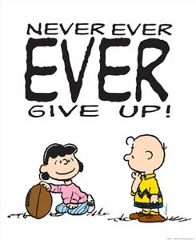
Seek Professional Help
Be safe, not sorry!
Take appropriate action when
needed to protect your child
Feel that something is not right
Notice warning signs in your child (including worsening signs)
Recognize if your child has a lot of risk
factors for suicide and few protective factors

Slide 38
Seek Professional Help
Find a mental health provider that has experience with suicidal youth
Choose a mental health provider with whom you and your child feel comfortable
Participate actively in therapy with your child
Call 911 or take your child to a hospital in case of an emergency
Suicidal thoughts or behaviors are a mental health emergency

Slide 39
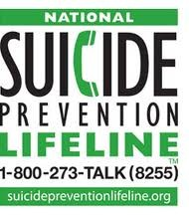
Resources
Suicide Prevention Resource Center (sprc.org)
American Association of Suicidology
(suicidology.org)
American Foundation for Suicide Prevention
(afsp.org)
Society for the Prevention
of Teen Suicide (sptsusa.org)
“Not My Kid” video
Several Handouts Available

Slide 40
Questions or Comments?
Dorian A. Lamis, PhD, ABPP
dorian.lamis@emory.edu

